Slide 1



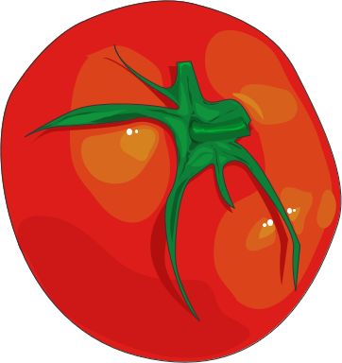
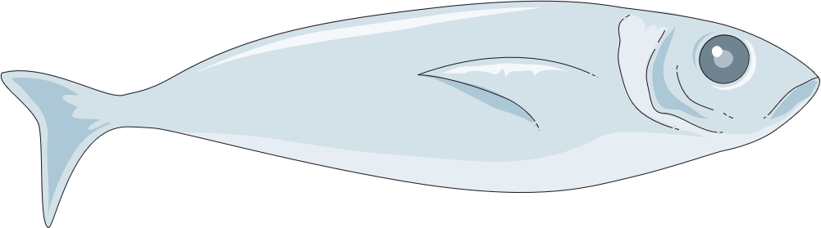
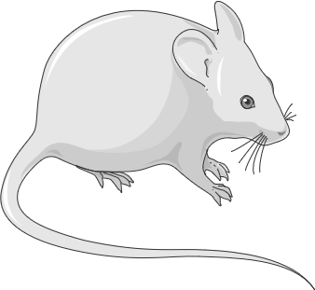






Samples clearing guidelines
Plant
Zebrafish
Parteners labs :
Mice/Rat
Others : Pork…
Use diaporama viewer
Click on the picture to select your sample type

Slide 2
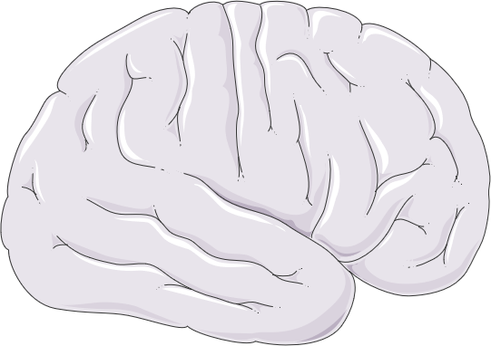
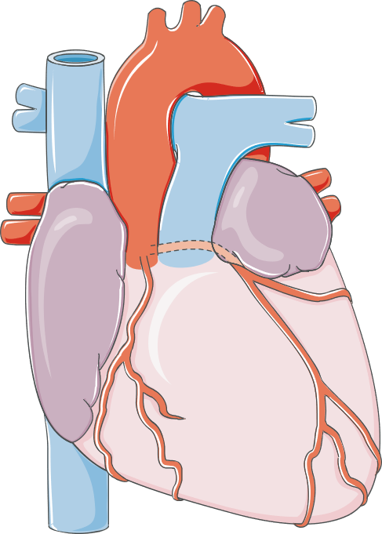
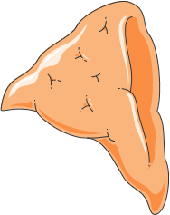
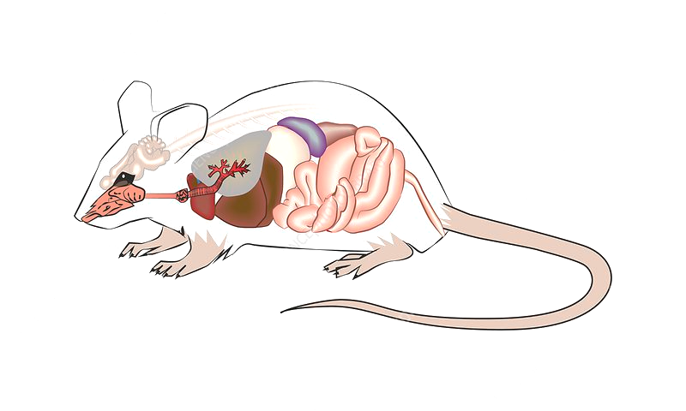
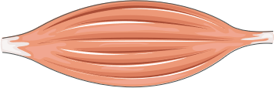
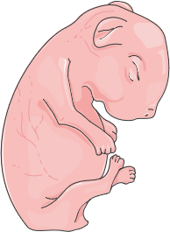

Mice/Rat organs
Central Nervous System
Heart
Adrenal
Muscles
Embryon
Liver
Summary

Slide 3
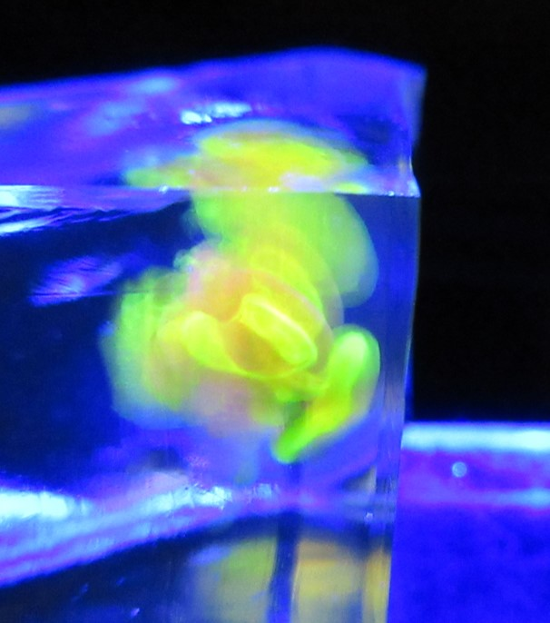

SHEET TITLE: Fish/Brain/Label | Corresponding Author : Matthieu Simion
Biological question: whole brain staining of nuclei and axonal tracts for neuroanatomical analysis in fishes
Sample description:
dissected brain from fish
dimension range from 3x1.5x2 mm³ to 17x10x8 mm³
cellular resolution
targeted molecules : DNA and lipids
fluorescent probes : YOYO-1 Iodide (Y3601, ThermoFisher Scientific),
DiI (D282, ThermoFisher Scientific)
Clearing methods used : adapted from CUBIC-L/CUBIC-R method
Protocol timing : clearing = size dependent from 1 to 6 days of delipidation and 2 to 5 days of RI matching
labelling = size dependent from 2 to 6 days per stain.
Toxicity of the products used :
Bibliography related to your protocol :
- Different ways of evolving tool-using brains in teleosts and amniotes (Estienne, P. et al.)
bioRxiv 2022.11.04.515163; doi: https://doi.org/10.1101/2022.11.04.515163
- Chemical Landscape for Tissue Clearing Based on Hydrophilic Reagents (Tainaka, K. et al.).
Cell Rep 24, 2196-2210.e9. https://doi.org/10.1016/j.celrep.2018.07.056.
Microscope(s) used : light-sheet microcopes (lighsheet 7, Zeiss and Ultramicroscope II, Miltenyi Biotech)
Time acquisition: size and resolution dependent from 15 minutes to a few hours
Image size: size and resolution dependent from tens to hundreds of Gb
Tips & tricks:
This protocol should work with other types of brain. It is compatible with immunolabeling. Antibodies can be added in the staining solution together with DiI. To avoid bubbling of the specimen during depigmentation, I recommend to wash it thoroughly in PBS with 0.05% sodium azide (at least 24h at room temperature, ! sodium azide is toxic ! ) before this step. Sodium azide is a strong inhibitor of catalases which convert H₂0₂ into water and O₂. Included in a depigmentation step, it can reduce its duration and avoids tissue damage caused by O₂ bubbles.
Click next sheet
Protocol
(download)
Summary

Slide 4
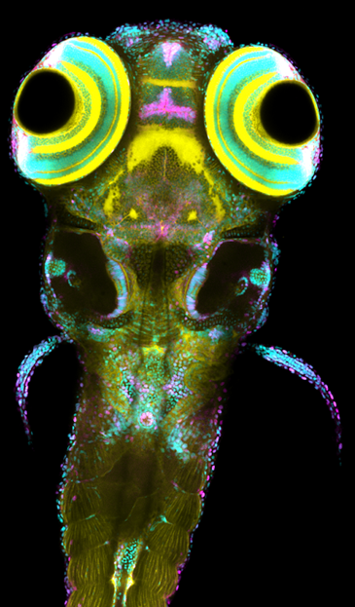
SHEET TITLE: Zebrafish/Wholemount/Label | Corresponding Author : Matthieu Simion
Biological question: caracterization of GFP reporter lines in zebrafish at 5 days post-fertilization
Sample description:
5 days post-fertilization zebrafish larvae
dimension range from 4x0.5x0.5 mm³
cellular resolution
targeted molecules : GFP + DNA and/or lipids
fluorescent probes : anti-GFP 555 (Invitrogen, A-31851),
DiO (D275, ThermoFisher Scientific) and YOYO-1 Iodide (Y3601, ThermoFisher Scientific)
Clearing methods used : adapted from CUBIC method
Protocol timing : clearing = 1 day of RI matching labelling = 3 days
Toxicity of the products used :
Bibliography related to your protocol :
ZeBraInspector, a platform for the automated segmentation and analysis of body and brain volumes
in whole 5 days post-fertilization zebrafish following simultaneous visualization with identical orientations
(Lempereur, S. et al.). Developmental Biology 490, 86–99. https://doi.org/10.1016/j.ydbio.2022.07.004
Microscope(s) used : confocal microcope (A1R, NIKON), upright configuration (CFI Plan Apo 10XC Glyc objective)
Time acquisition: resolution dependent from 5 minutes to 2 hours per larvae
Image size: resolution dependent from hundreds of Mb to more than 10 Gb.
Tips & tricks:
This protocol works with other antibodies. DiO and YOYO-1 provides anatomical landmarks to accurately localize GFP expression in the whole larva. Sytox Deep Red in not compatible with the in-house RI matching solution used in this protocol. Other water-based RI matching solutions such as CUBIC-2 can be used in replacement. This protocol does not include a delipidation step to limit protein loss. In consequence, larvae are not perfectly transparent and a small signal decay may occur in depth. These samples are too big for imaging with an AiryScan detector (Zeiss) : post-processing will fail. This protocol could be used on small organoids (a few hundreds of micrometers in diameter)
Protocol
(download)
Summary

Slide 5
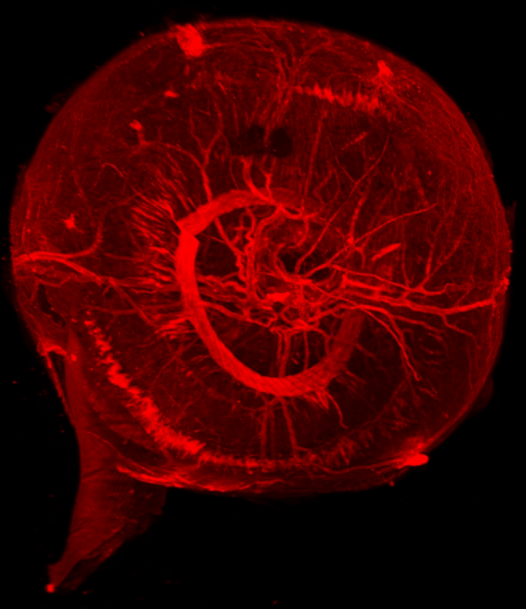


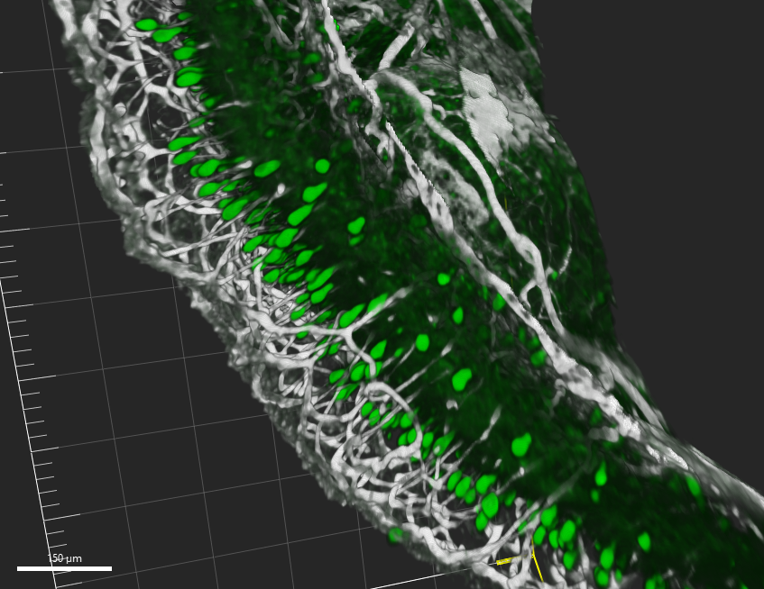
SHEET TITLE: Mice/Eye/Label | Corresponding Author : David Godefroy
Biological question: whole eye staining of nuclei and axonal tracts for neuroanatomical analysis
Sample description:
Perfused (PFA 4%) and dissected eye from mice
diametre 2 mm
fibers resolution
targeted molecules : proteins
fluorescent probes : secondary antibody-Alexa, Cyanine
Clearing methods used : iDISCO+
Protocol timing : delipidation and bleaching : 2 days, bleach with 11% H₂O₂ with Light-Emitting Diode (LED) (3000˚ Kelvin)
labelling = size dependent from 14 days.
clearing = 2 days of RI matching
Toxicity of the products used :
Bibliography related to your protocol :
- Revisiting the role of Dcc in visual system development with a novel eye clearing method (Vigourous, RJ. et al.), elife,doi: https://doi.org/10.7554/eLife.51275
- Mapping of Brain Activity by Automated Volume Analysis of Immediate Early Genes (Renier, N. et al.), cell
doi : http://dx.doi.org/10.1016/j.cell.2016.05.007
- In utero alcohol exposure impairs retinal angiogenesis and the microvessel-associated positioning of calretinin interneurons (Dumanoir, M. et al.), eNeuro, 2023, in press
Microscope(s) used : light-sheet microcopes (Ultramicroscope II, Miltenyi Biotech)
Time acquisition: size and resolution dependent (30 minutes to a few hours by wavelenght)
Image size: size and resolution dependent from tens to hundreds of Gb
Tips & tricks:
This protocol should work with other types of brain. Multiple antibodies can be added in the staining solution together. Clearing is performed in 15 ml falcons at room temperature. Samples are stored at room temperature in Benzyl Ether.
Click next sheet
Summary
Protocol
(download)
Source: Dumanoir, M. et al.2023

Slide 6
SHEET TITLE: Mice/Brain/Label | Corresponding Author : David Godefroy
Biological question: whole brain staining of nuclei and axonal tracts for neuroanatomical analysis
Sample description:
Perfused (PFA 4%) and dissected brain from mice
dimension max 10x8x6 mm³
fibers resolution (250nm)
targeted molecules : DNA, proteins
fluorescent probes : secondary antibody-Alexa, Cyanine and TOPRO
Clearing methods used : iDISCO+
Protocol timing : delipidation : 2 days
labelling = size dependent from 10 to 14 days.
clearing = 2 days of RI matching
Toxicity of the products used :
Bibliography related to your protocol :
- Three-dimensional mapping of tyrosine hydroxylase in the transparent brain and adrenal of prenatal and pre-weaning mice: Comprehensive methodological flowchart and quantitative aspects of 3D mapping (Godefroy, D. et al.), doi: https://doi.org/10.1016/j.jneumeth.2020.108596
- Mapping of Brain Activity by Automated Volume Analysis of Immediate Early Genes (Renier, N. et al.),
doi : http://dx.doi.org/10.1016/j.cell.2016.05.007
Microscope(s) used : light-sheet microcopes (Ultramicroscope II, Miltenyi Biotech)
Time acquisition: size and resolution dependent (30 minutes to a few hours by wavelenght)
Image size: size and resolution dependent from tens to hundreds of Gb
Tips & tricks:
This protocol should work with other types of brain. Multiple antibodies can be added in the staining solution together. Topro is added to the last wash. Clearing is performed in 15 ml falcons at room temperature. Samples are stored at room temperature in Benzyl Ether.
Click next sheet
Protocol
(download)
Summary

Slide 7
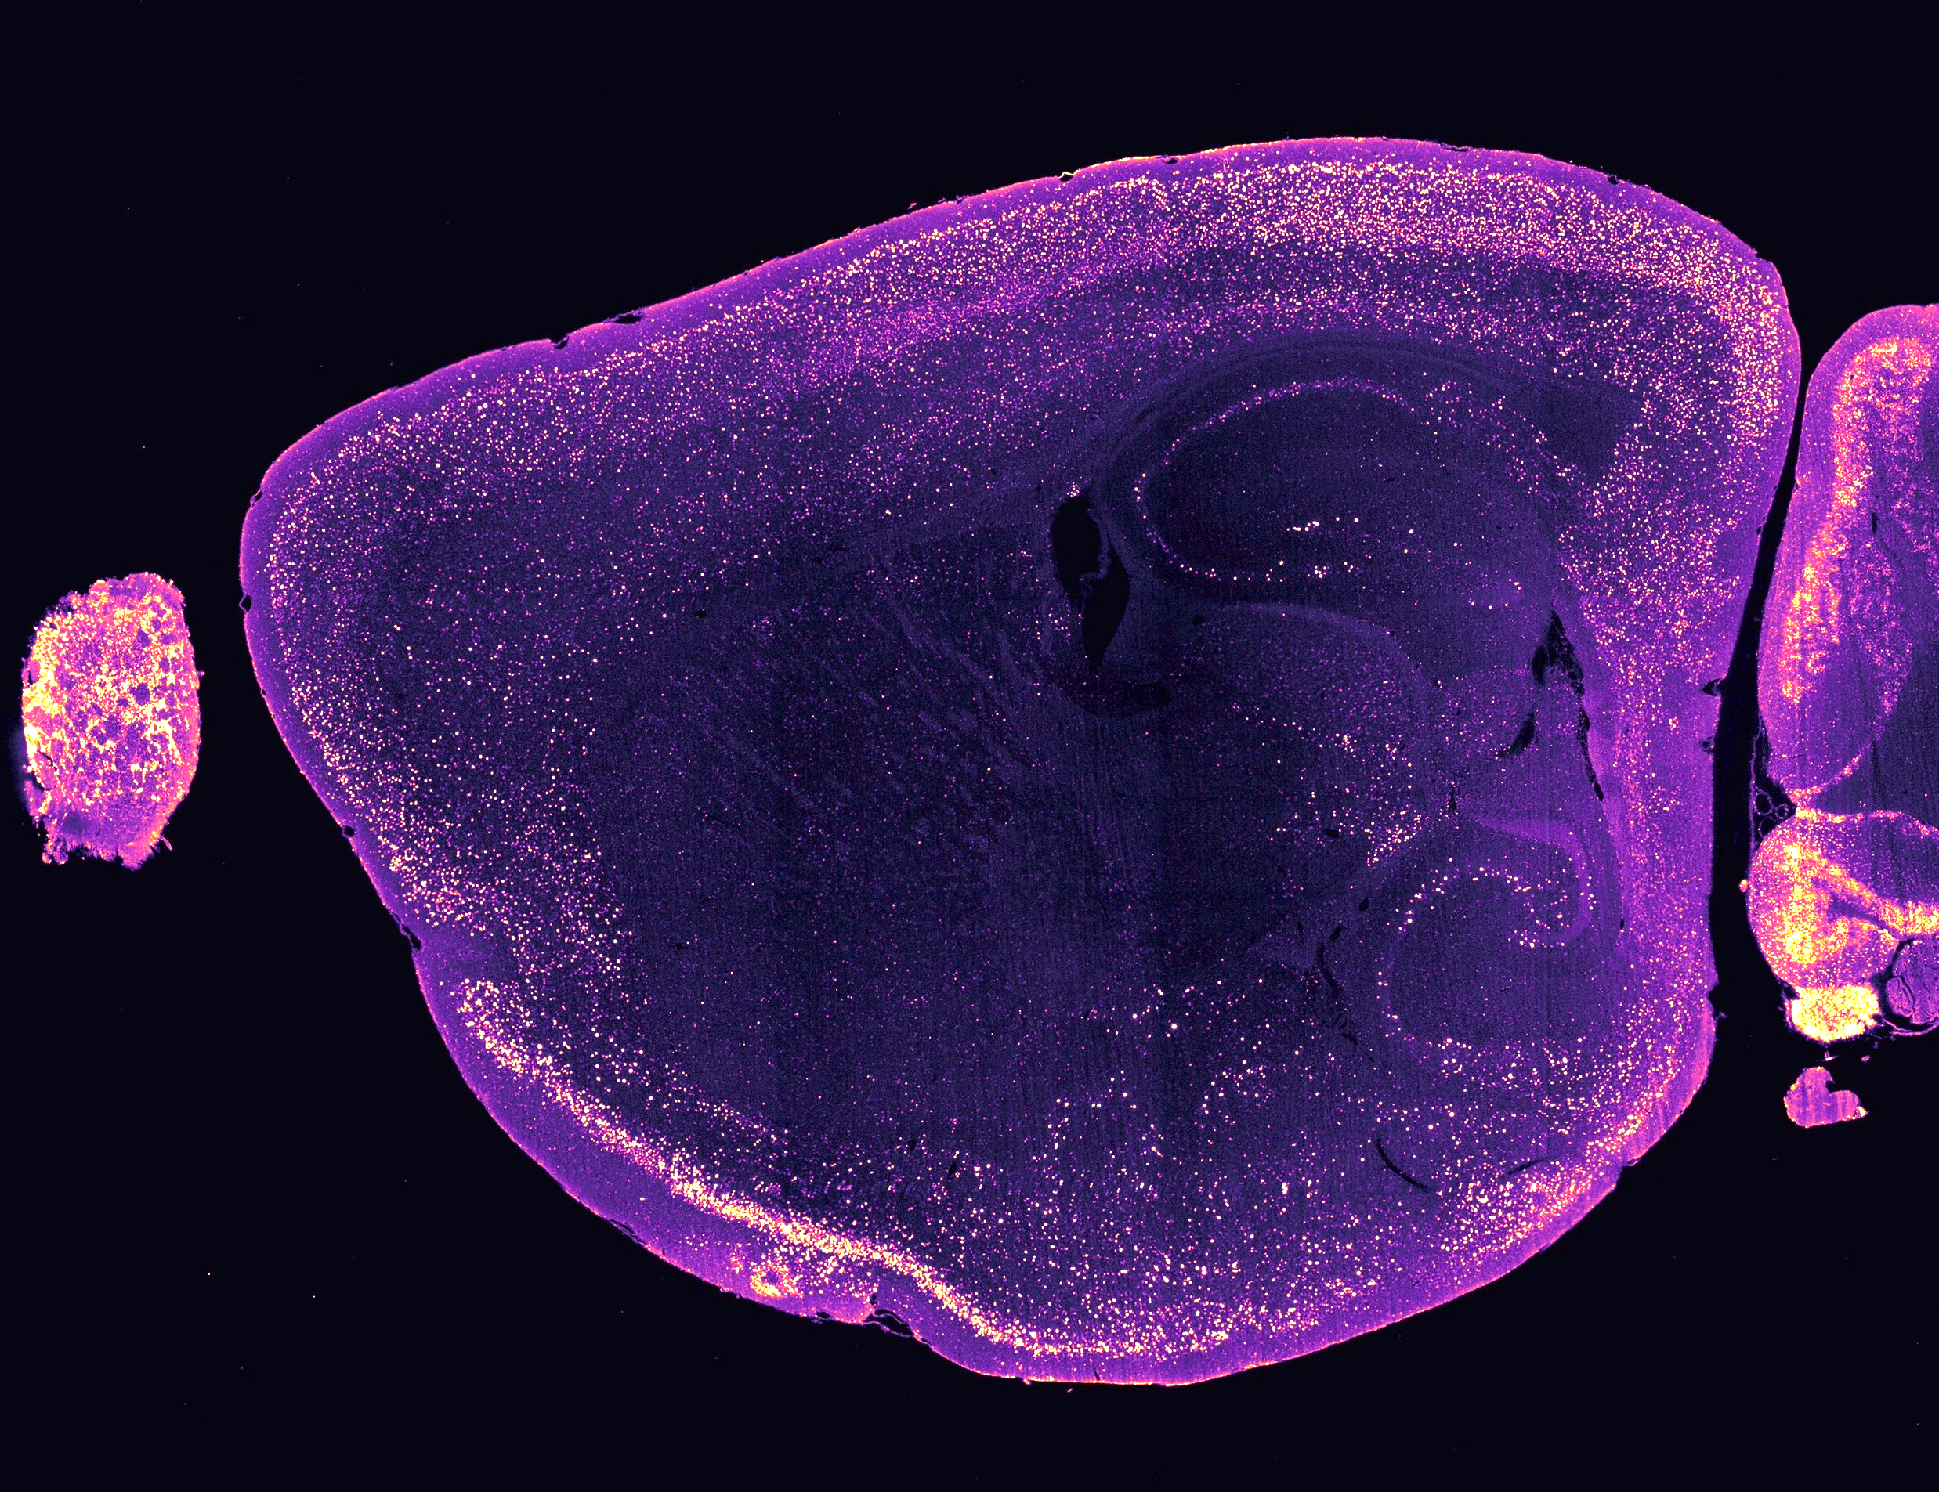
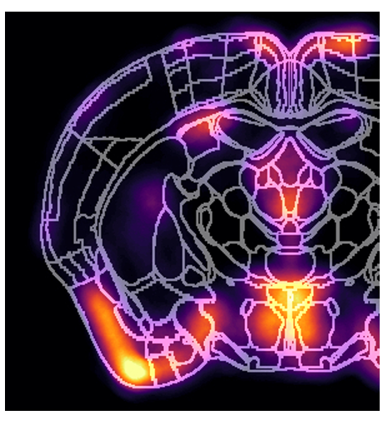


SHEET TITLE: Mouse – Brain – cFOS immunolabelling | Corresponding Author : Jérémie Teillon
Biological question: Mapping entire brain activity by CFOS labelling
Sample description:
- mouse brain
- 1 x 1 x 0.6 cm
- Cellular resolution
- cFOS protein
Clearing methods used : IDISCO
Protocol timing : clearing = 2 days immunolabelling = 3 weeks
Toxicity of the products used:
Bibliography related to your protocol :
Mapping of brain activity by automated volume analysis of immediate early genes
10.1016/j.cell.2016.05.007
Microscope(s) used : Type ; light sheet microscope, Ultramicroscope II, Lavision.
Time acquisition: 3 hours
Image size: 20 Go
Image analysis (optional): Clearmap 2 (https://github.com/ChristophKirst/ClearMap2)
Tips & tricks:
Dilution of the antibody has to be tested for every new batch of antibody
Protocol
(download)
Summary

Slide 8
SHEET TITLE: Mice/Adrenal/Label | Corresponding Author : David Godefroy
Biological question: whole adrenal staining of nuclei and axonal tracts for neuroanatomical analysis
Sample description:
Perfused (PFA 4%) and dissected adrenal from mice
dimension max 2x2x2 mm³
fibers resolution (250nm)
targeted molecules : DNA, proteins
fluorescent probes : secondary antibody-Alexa, Cyanine and TOPRO
Clearing methods used : iDISCO+
Protocol timing : delipidation : 2 days
labelling = size dependent from 10 to 14 days.
clearing = 2 days of RI matching
Toxicity of the products used :
Bibliography related to your protocol :
- Three-dimensional mapping of tyrosine hydroxylase in the transparent brain and adrenal of prenatal and pre-weaning mice: Comprehensive methodological flowchart and quantitative aspects of 3D mapping (Godefroy, D. et al.), doi: https://doi.org/10.1016/j.jneumeth.2020.108596
- Mapping of Brain Activity by Automated Volume Analysis of Immediate Early Genes (Renier, N. et al.),
doi : http://dx.doi.org/10.1016/j.cell.2016.05.007
Microscope(s) used : light-sheet microcopes (Ultramicroscope II, Miltenyi Biotech)
Time acquisition: size and resolution dependent (30 minutes to a few hours by wavelenght)
Image size: size and resolution dependent from tens to hundreds of Gb
Tips & tricks:
This protocol should work with other types of brain. Multiple antibodies can be added in the staining solution together. Topro is added to the last wash. Clearing is performed in 15 ml falcons at room temperature. Samples are stored at room temperature in Benzyl Ether.
Protocol
(download)
Summary

Slide 9
SHEET TITLE: Mice/Embryo/Label | Corresponding Author : David Godefroy
Biological question: whole embryo staining of nuclei and axonal tracts for neuroanatomical analysis
Sample description:
Perfused (PFA 4%)
dimension max 6x3x2 mm³
fibers resolution (250nm)
targeted molecules : DNA, proteins
fluorescent probes : secondary antibody-Alexa, Cyanine and TOPRO
Clearing methods used : iDISCO+
Protocol timing : delipidation : 2 days
labelling = size dependent from 10 to 14 days.
clearing = 2 days of RI matching
Toxicity of the products used :
Bibliography related to your protocol :
- Three-dimensional mapping of tyrosine hydroxylase in the transparent brain and adrenal of prenatal and pre-weaning mice: Comprehensive methodological flowchart and quantitative aspects of 3D mapping (Godefroy, D. et al.), doi: https://doi.org/10.1016/j.jneumeth.2020.108596
- Mapping of Brain Activity by Automated Volume Analysis of Immediate Early Genes (Renier, N. et al.),
doi : http://dx.doi.org/10.1016/j.cell.2016.05.007
Microscope(s) used : light-sheet microcopes (Ultramicroscope II, Miltenyi Biotech)
Time acquisition: size and resolution dependent (30 minutes to a few hours by wavelenght)
Image size: size and resolution dependent from tens to hundreds of Gb
Tips & tricks:
This protocol should work with other types of brain. Multiple antibodies can be added in the staining solution together. Topro is added to the last wash. Clearing is performed in 15 ml falcons at room temperature. Samples are stored at room temperature in Benzyl Ether.
Protocol
(download)
Summary

Slide 10
SHEET TITLE: Mice/Heart/Label | Corresponding Author : David Godefroy
Biological question: whole heart staining of fibers nerves, lymphatics, and vasculars tracts
Sample description:
Perfused (PFA 4%) and dissected heart from mice
dimension max 10x6x6 mm³
fibers resolution (250nm)
targeted molecules : proteins
fluorescent probes : secondary antibody-Alexa, Cyanine
Clearing methods used : iDISCO+
Protocol timing : delipidation : 2 days
labelling = size dependent from 10 to 14 days.
clearing = 2 days of RI matching
Toxicity of the products used :
Bibliography related to your protocol :
Lymphatic and Immune Cell Cross-Talk Regulates Cardiac Recovery After Experimental Myocardial Infarction (Houssari, M. et al.), ATVB, doi: 10.1161/ATVBAHA.120.314370
Regulation and impact of cardiac lymphangiogenesis in pressure-overload-induced heart failure (Heron, C. et al.), Cardiovasc Res, DOI : 10.1093/cvr/cvac086
- Mapping of Brain Activity by Automated Volume Analysis of Immediate Early Genes (Renier, N. et al.), Cell
doi : http://dx.doi.org/10.1016/j.cell.2016.05.007
Microscope(s) used : light-sheet microcopes (Ultramicroscope II, Miltenyi Biotech)
Time acquisition: size and resolution dependent (30 minutes to a few hours by wavelenght)
Image size: size and resolution dependent from tens to hundreds of Gb
Tips & tricks:
This protocol should work with other types of organs. Multiple antibodies can be added
in the staining solution together. Clearing is performed in 15 ml falcons at room
temperature. Samples are stored at room temperature in Benzyl Ether.
Protocol
(download)
Summary

Slide 11
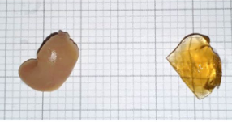
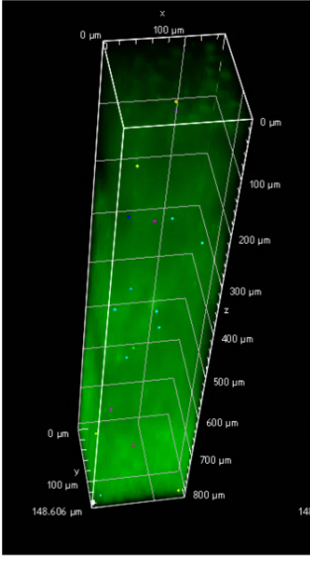

SHEET TITLE: liver mice (far red fluorescente probe, green autofluorescence) | Corresponding Author : Laurence Dubreil
Biological question: Fluorescent tracking of immune cells in the liver with a highly biocompatible far‑red emitting polymer probe. The labelled primary CD8
T cells were tracked in liver of a mouse model of immune cell infiltration.
Sample description:
- liver
- dimension 5x1x10 mm³
- résolution (cellular, tissular)
- labeled lymphocytes
- fluorescent probe 19K6H
Clearing methods used : CUBIC-L/R
Protocol timing : clearing = 7 days immunolabelling = no
Toxicity of the products used :
Bibliography related to your protocol : Daniel M, Dubreil L, Fleurisson R, Judor JP, Bresson T, Brouard S, Favier A, Charreyre MT, Conchon S. Multiscale fluorescent tracking of immune cells in the liver with a highly biocompatible far-red emitting polymer probe. Sci Rep. 2020 Oct 16;10(1):17546. doi: 10.1038/s41598-020-74621-9. PMID: 33067572; PMCID: PMC7567820.
Microscope(s) used : Type ; Multiphoton A1RMP, right; objective X25 MP1300 immersion objective (NA 1.10) WD 2.0 mm
Time acquisition: 20 min for 0.176x1x0,176 mm³ with step 0,5µm, resonnant scanner 1024X1024, 15 frames/sec, av16
Image size: 4Go, detection of autofluorescence and far red fluorescence of 19K6H (2 channels)
Image analysis (optional) : Total 3D volume of cells labeled with 19K6H, 3D volume segmented objects, were determined using the GA3 module in the NIS-Elements software package (5.30.03 Nikon Instruments Inc., Nikon Europe B.V.).
Tips & tricks:
Please give some informations about : what did not work, blocking steps, if special mounting process are used (described int the protocol), others
Detection of red fluorescent pCD8 T cell in cleared liver.
Protocol
(download)
Summary

Slide 12
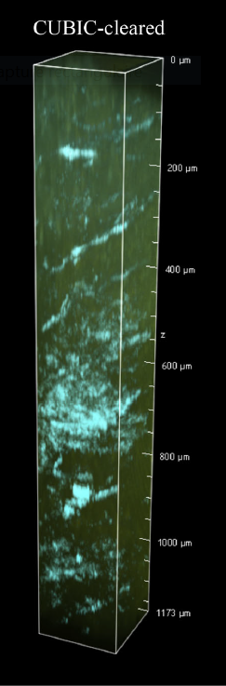
SHEET TITLE: Rat – muscle – label free (FP, SHG, autofluorescence) | Corresponding Author : Laurence Dubreil
Biological question:
Sample description:
- cardiac muscle
- dimension 15x2x15 mm³
- résolution (cellular, tissular)
- collagen fiber
- no fluorescent probe
Clearing methods used : CUBIC-L/R
Protocol timing : clearing = 11 days immunolabelling = no
Toxicity of the products used :
Bibliography related to your protocol : Susaki, E.A., Tainaka, K., Perrin, D., Yukinaga, H., Kuno, A. & Ueda, H.R. (2015) Advanced CUBIC protocols for whole-brain and whole-body clearing and imaging. Nature Protocols, 10(11), 1709–1727. Pichon J, Ledevin M, Larcher T, Jamme F, Rouger K, Dubreil L. Label-free 3D characterization of cardiac fibrosis in muscular dystrophy using SHG imaging of cleared tissue. Biol Cell. 2022 Mar;114(3):91-103
Microscope(s) used : Type ; Multiphoton A1RMP, right; objective X25 MP1300 immersion objective (NA 1.10) WD 2.0 mm
Time acquisition: 20 min for 0.176x1x0,176 mm³ with step 0,5µm, resonnant scanner 1024X1024, 15 frames/sec, av16
Image size: 4Go, detection of backward and forward SHG (2 channels)
Image analysis (optional) : Total 3D volume of SHG, 3D volume segmented objects, 3D elongation objects, and 3D orientation objects were determined using the GA3 module in the NIS-Elements software package (5.30.03 Nikon Instruments Inc., Nikon Europe B.V.). Orientation J can be also used with Fiji software)
Tips & tricks:
Please give some informations about : what did not work, blocking steps, if special mounting process are used (described int the protocol), others
Collagen accumulation is an important pathological feature of dystrophic muscle. The aim of muscle clearing is 3D collagen organization analysis by Second Harmonic Generation microscopy
Protocol
(download)
Summary

Slide 13
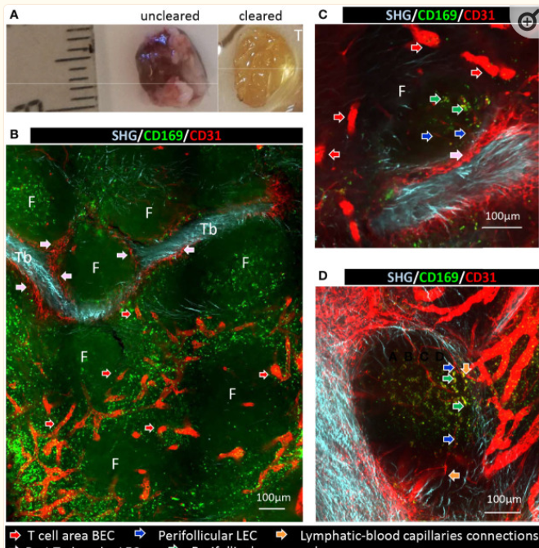
SHEET TITLE: Porc – lymph Node – Fluorescent Immunolabeling (CD69, CD31) | Corresponding Author : Laurence Dubreil
Biological question: Description of the complex interconnections between afferent lymphatics and blood vessels, perifollicular macrophages, follicular B cells and efferent blood vessels in inverted swine lymh node.
Sample description:
- Lymph Node
- dimension 10x7x3mm³) and thick section of a large lymph node (10x5x2 mm³).
- resolution (cellular, tissular)
- vessels, macrophages, collagen from trabecule
- fluorescent probe : Alexa fluor 488, Alexa fluor 555
Clearing methods used : iDISCO+
Protocol timing : clearing = 21 days immunolabelling = yes
Toxicity of the products used :
Bibliography related to your protocol : Dubreil L, Ledevin M, Hervet C, Menard D, Philippe C, Michel FJ, Larcher T, Meurens F, Bertho N. The Internal Conduit System of the Swine Inverted Lymph Node. Front Immunol. 2022 Jun 6;13:869384.
Microscope(s) used : Type ; Multiphoton A1RMP, right; objective X25 MP1300 immersion objective (NA 1.10) WD 2.0 mm
Time acquisition: 20 min for 0.176x1x0,176 mm³ with step 0,5µm, resonnant scanner 1024X1024, 15 frames/sec, av16
Image size: 4Go, detection of fluorescence in backward , detection of SHG in forward SHG (3 channels)
Image analysis (optional) : 3D reconstruction (5.30.03 Nikon Instruments Inc., Nikon Europe B.V.).
Tips & tricks:
Please give some informations about : what did not work, blocking steps, if special mounting process are used (described int the protocol), others
Protocol
(download)
Summary

Slide 14
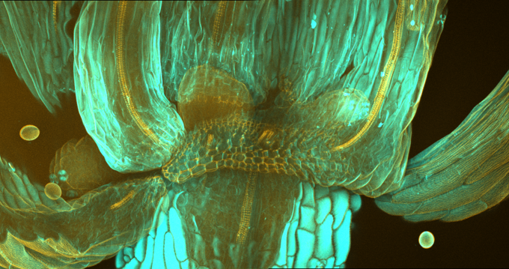
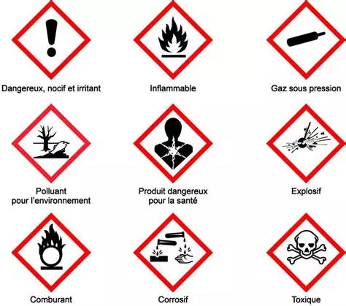
SHEET TITLE: Arabidopsis thaliana/flower/lignine and cellwall staining – lignine autofluorescence | Corresponding Author : Katia Belcram
Biological question: caracterization of the floral organ abscission
Sample description:
- Flower
- dimension LxHxW mm
- cellular resolution
- targeted molecules : cellulose, lignin
- fluorescent probes : fluorescent brightener 28, Basic Fuchsin
Clearing methods used : Clearsee
Protocol timing : clearing = ovn staining = ovn
Toxicity of the products used :
Bibliography related to your protocol :
- Floral organ abscission in Arabidopsis requires the combined activities of three TALE homeodomain transcription factors (Crick et al.)
Journal of Experimental Botany, Volume 73, Issue 18, 18 October 2022, Pages 6150–6169, https://doi.org/10.1093/jxb/erac255
- A protocol for combining fluorescent proteins with histological stains for diverse cell wall component (Ursache et al.)
Plant J. 2018 Jan;93(2):399-412.doi: 10.1111/tpj.13784. PMID: 29171896 DOI: 10.1111/tpj.13784
- ClearSee: a rapid optical clearing reagent for whole-plant fluorescence imaging (Kurihara et al.)
Development. 2015 Dec 1;142(23):4168-79. doi: 10.1242/dev.127613 Epub 2015 Oct 22.
Microscope(s) used : inverted Zeiss Observer Z1 spectral confocal laser microscope LSM 710 obj :40x (506179, NA: 1.3, WD: 210 μm)
Time acquisition:
Image size: 3072x 2048, voxel size : 0.5x0.5x1
Tips & tricks:
Use plastic baskets to transfer samples from well to well to preserve samples.
Use double-sided adhesive tape as spacers.
Click next sheet
Protocol
(download)
Summary

Slide 15
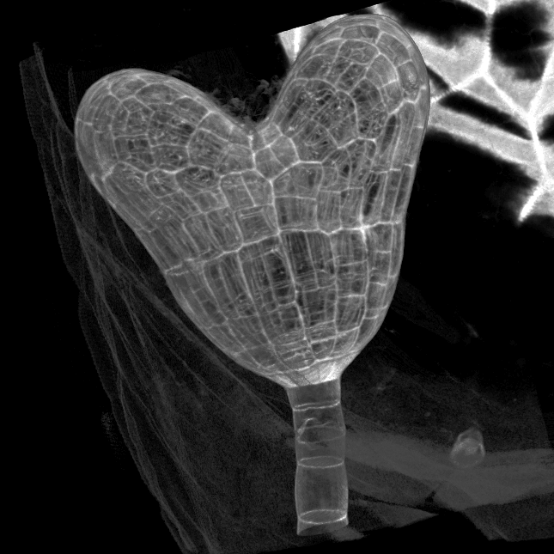
SHEET TITLE: Arabidopsis thaliana/embryo/cellwall staining | Corresponding Author : Katia Belcram
Biological question: caracterization of the embryo development
Sample description:
- Embryo within intact seeds
- dimension LxHxW mm
- cellular resolution
- targeted molecules : cellulose
- fluorescent probes : fluorescent brightener 28
Clearing methods used : Scale A2
Protocol timing : clearing = 2 days staining = 2 days
Toxicity of the products used :
Bibliography related to your protocol :
- Studying Cell Division Plane Positioning in Early-Stage Embryos (Belcram et al.)
Methods Mol Biol. 2022;2382:141-154. doi: 10.1007/978-1-0716-1744-1_9. PMID: 34705238 DOI: 10.1007/978-1-0716-1744-1_9
- Cell geometry determines symmetric and asymmetric division plane selection in arabidopsis early embryos. (Moukhtar et al.)
PLOS Computational Biology 15:e1006771. DOI: https://doi.org/10.1371/journal.pcbi.1006771, PMID: 30742612
- Large-scale analysis and computer modeling reveal hidden regularities behind variability of cell division patterns in Arabidopsis thaliana embryogenesis (Laruelle et al.)
eLife Nov 29, 2022 https://doi.org/10.7554/eLife.79224
Microscope(s) used : inverted Zeiss Observer Z1 spectral confocal laser microscope LSM 710 obj :40x (506179, NA: 1.3, WD: 210 μm)
Time acquisition: 5-15’
Image size: 512x256-512x…, voxel size : 0.35x0.35x0.35
Image analysis (optional) :
- Segmentation with morpholibJ (FIJI)
- Cell size, cell morphology, lineage
Tips & tricks:
Use plastic baskets to transfer samples from well to well to preserve samples.
Use double-sided adhesive tape as spacers.
Protocol
(download)
Summary

Slide 16
1/2
Protocol for iDISCO+ clearing and immunostaning in toto
iDISCO+ clearing protocole and immunolabeling were performed on a small whole lymph node (10x7x3mm³) and thick section of a large lymph node (10x5x2 mm³).
Samples were fixed in PBS/4% PFA at 4°C, overnight with shaking, then washed in PBS at room temperature (RT) 30 min, 3 times.
Sample dehydration was performed using methanol in water increasing concentration serial solutions:20%, 40%, 60%, 80%, 100%, 1 h each.
Thereafter, dehydrated samples were washed for 1h in 100% methanol followed by overnight incubation, with shaking, in 66% dichloromethane (Sigma-Aldrich)/33% methanol at RT. Then samples were washed twice in 100% methanol at RT. (optional step).
Sample bleaching was done in chilled fresh 5% H₂O₂ in methanol (1 volume 30% H₂O₂ to 5 volumes methanol), overnight at 4°C.
Then sample rehydration was obtained using methanol in water decreasing concentration serial solutions: 80%, 60%, 40%, 20%, 1 h each at RT and washed twice in PBS 0.2% tritonX100 at RT 1 h.
Samples were then incubated for 2 days at 37°C in permeabilization solution (0.2% Triton, 20% DMSO, 0.3M Glycine, 0.05% sodium azide in PBS)
then incubated for another 4 days at 37°C blocking solution (0.2% Triton, 10% DMSO, 6% goat serum, 6% swine serum, 0.05% sodium azide in PBS).
Primary antibodies were incubated for 7 days at 37°C in staining solutions (PBS/Tween, 0.01% sodium azide, 10 µg/mL heparin, 10% DMSO, 3% horse serum, 3% swine serum, 100 µg/mL saponin in PBS).
Click next sheet
Summary

Slide 17
Samples were washed in PBS 0.1% tween 80, for 4-5 times, during 2 days at RT.
Secondary antibodies were incubated in staining solution for 7 days at 37°C.
Finally, samples were washed 5 times at RT during 2 days in PBS/tween, 10 µg/mL heparin.
Clearing sample was performed using methanol in water increasing concentration serial solutions:20%, 40%, 60%, 80%, 2x100%, 1 h each, minimum 3 h in 66% dichloromethane (Sigma-Aldrich)/33%, 2x15 min in dichloromethane (Sigma-Aldrich) and minimum 3h in benzylether (Sigma-Aldrich).
2/2
Summary

Slide 18
Protocol CUBIC-L/R
1-Samples were collected and transferred to tubes containing 4% paraformaldehyde for fixation and storage at 4°C.
2-Fixed tissus were transversally cut into 2-mm thick sections for CUBIC clearing.
Tissue transparency was obtained by using two successive hydrophilic reagents:
CUBIC-L (T3740, TCI), 7 days with 1-methylimidazole for decolorization and aliphatic diol for delipidation; and CUBIC-R, 3 days (T3741, TCI) with N-methylnicotinamide for refractive index matching (1.52) to minimize light scattering inside the tissue and antipyrine to avoid tissue shrinkage (Tainaka et al., 2018).
2-1 Sections of fixed hearts were washed in PBS for 24 h at room temperature (RT) and incubated with CUBIC-L for 7 days with gentle shaking at 37°C.
2-2 Delipidated samples were washed in PBS and incubated with CUBIC-R with gentle shaking at RT for 3 days. All steps of the clearing procedure were performed in a 24-well culture plate containing at least 1.5 ml of solution.
2-3 Cleared sample section was mounting in CUBIC-R between slide and coverslide using spacers.
2-4 TDE (2-Thiodiethanol) was deposited between coverslide and objective.
Summary

Slide 19
1/2
Click next sheet
Summary

Slide 20
2/2
Summary

